Slide 1
Deployment and Operations for Software Engineers 2nd Ed
Chapter 11 – Deployment pipeline 1

Slide 2
Outline
Overview
Environments
Development environment
Integration environment
Staging environment
Deployment
2

Slide 3
Overview of a deployment pipeline
The deployment pipeline is the sequence of actions that move the code you write into production.
We will present it as four stages – development, integration, staging, production.
Integration is also called build.
Organizations vary these stages
Some have no staging
Some hage multiple staging
Each stage has a separate environment—separated from other environments
3

Slide 4
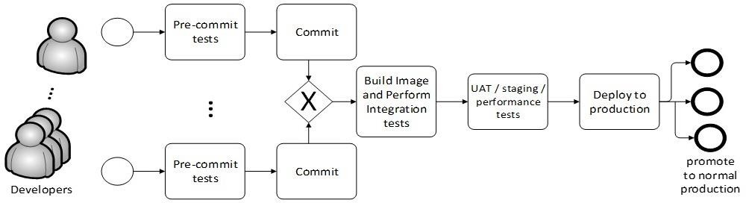
Deployment pipeline
4

Slide 5
Types of tests
One purpose of each environment is to perform tests. Two types of tests can be used
Runtime tests
Static Analysis

Slide 6
Runtime tests
The portion of the system being tested is executed and a set of tests are run on it. This requires a test harness.

Slide 7
Static analysis
This type of testing is applied to the source code. Using techniques similar to those used in compilers, a static analyzer looks for problematic code constructions. Static analyzers have both false positives and false negatives. The type of problems flagged by a static analyzer are those that can be found in the Common Weakness Enumeration CWE).
The CWE is a list of software weakness types..

Slide 8
Development environment overview
In the development environment, you develop your modules.
Unit tests are run on each module.
The module is checked into the version control system. This triggers the integration stage.

Slide 9
Build/integration environment overview
The build server compiles your new or changed code,
It also compiles the code of other portions of your service.
If you are working in an interpreted language such as Python or Javascript, there are no compilation steps.
The build server constructs an executable image for your service.
This executable image is then tested for functional correctness.
After the executable image passes your service’s functional tests, the staging environment is triggered.

Slide 10
Staging environment overview
Tests the quality of the service
performance under load,
security vulnerabilities,
Compliance with regulations and licenses.
User-acceptance testing (UAT) may occur at this stage depending on the business context of your service.
Once the service passes its quality tests it is
Placed into production if you are doing continuous deployment
Marked as ready for deployment if you are doing continuous delivery

Slide 11
Production environment overview
Once in production, the service is monitored closely until there is some confidence about its quality.
At that point, it is considered a normal part of the system and receives the same amount of attention as the other parts of the system.

Slide 12
Qualities of the pipeline
Cycle time
Traceability
Repeatability
Security

Slide 13
Cycle time
Cycle time is the time taken to move through the pipeline.
If humans are involved, cycle time is much increased.
Continuous deployment depends on automated testing.

Slide 14
Traceability
Traceability is the ability track all of the elements of a service in production.
This includes
the code and dependencies that are included in that service.
The test cases that were run on that service
The tools that were used to produce the service.
Traceability information is kept in an artifact database. I
code version numbers,
dependency version numbers,
test version numbers,
tool version numbers.

Slide 15
Repeatability
Repeatability means that if you perform the same action with the same artifacts, you should get the same result.
This is not as trivial as it sounds. For example,
Your build process fetches the latest version of a dependency. The next time you execute the build process, a new version of the dependency may have been released.
One test modifies some values in the database. If the original values are not restored, subsequent tests will not produce the same results.

Slide 16
Flaky tests
Sometimes tests are not repeatable for a different reason. So called flaky tests.
One cause could be parallelism in the system. Two different executions of a test could take different paths because of timing differences with parallel threads.
Log examination is a method for resolving flaky tests.

Slide 17
Security
15-20% of security breaches are caused by insiders.
Techniques to reduce the possibility of an insider attack on the pipeline are
Limiting access to the pipeline tools,
keeping a record of changes and the originator of the changes,
Notifying team members that a pipeline tool has been updated or modified.

Slide 18
Discussion questions
What are the tradeoffs between doing quality testing in the integration step and doing it in a separate staging step?
What is the relation between cycle time and the number of deployments per day?

Slide 19
Outline
Overview
Environments
Development environment
Integration environment
Staging environment
Deployment
19

Slide 20
Purpose of an environment
The purpose of each environment, except for production, is to provide a place to perform testing that is isolated from other development or testing activities that might be ongoing.
The production environment is treated differently.

Slide 21
Requirements for an environment
The environment is isolated from other environments. Including
address spaces
inputs
modifications to any database
other dependencies on the processes being executed in the environment.

Slide 22
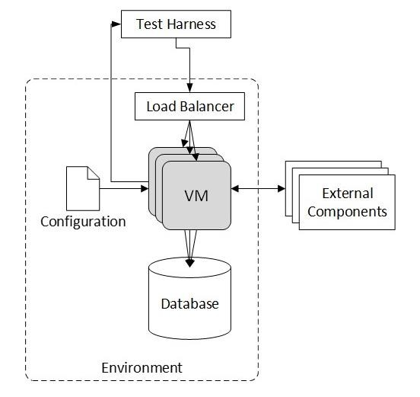
Elements of the environment
collection of virtual machines or containers
infrastructure services (for example, a load balancer)
a source of input for runtime tests
a database
configuration parameters
external services

Slide 23
Collection of Virtual Machines or Containers
The modules, services, or system being executed in this environment.
The collection of services in the environment grows as the system moves through the pipeline.
In a development environment, a single module is being tested;
in an integration environment, the service is being tested;
in a staging environment, the service plus other services is tested.

Slide 24
Infrastructure Services
Your service depends on infrastructure services.
In the development environment, you may need only a load balancer and logging,
In other environments you may need services such as registration and discovery.

Slide 25
Source of input
The purpose of each environment is to run tests, and tests require a source of input.
The input can come from
a test harness or dynamic workload generator
from live users
by replaying a previously captured input from live users.

Slide 26
Database
The database must be restored after each test.
The tests must be repeatable and give the same results every time they are run.
Any given test may modify data in the database. Restoring the database after each test ensures that each execution of each test begins from the same state.

Slide 27
Configuration Parameters
A configuration parameter is a value that is bound at runtime,
Each environment will have a set of configuration parameters
The configuration parameters will vary from environment to environment.

Slide 28
External Services
External services can range from a service that broadcasts the weather to one that performs authorization.
The treatment of these external services depends on which environment your service is in and whether the external service is read only or read/write.
If your service is not in the production environment and the external service is read/write, it must be stubbed or mocked.

Slide 29
Life cycle of an environment
An environment has a finite lifetime
Created
Used
Cleaned up
Creation and clean up can be automated

Slide 30
Create
The creation of an environment is triggered by some event.
Which event depends on the purpose of the environment

Slide 31
Actions of the create step
Create a VM or container loaded with your software.
Create a load balancer. The load balancer is a separate VM or is allocated from a PaaS or service mesh.
Create the test harness.
Initialize the database for the environment.
Create environment-dependent configuration parameters

Slide 32
Usage
Usage will vary depending on the purpose of the environment.

Slide 33
Clean up
Save any persistent artifacts created by the environment.
Adjust any necessary data.
Remove any resources created.

Slide 34
Variations
Other variations on the pipeline stages include
Test a complete service in the development stage (rather than just your own module), and then test the entire system (your service integrated with other services) in the integration stage.
Quality testing that we describe in staging is performed in the integration step
The integration stage might test “typical” customer use cases
Multiple staging environments exist for different purposes

Slide 35
Discussion questions
Would UAT testing be done in a separate staging environment or the normal staging environment? How would you do UAT testing with real users?
Where does the data in the test database come from?

Slide 36
Outline
Overview
Environments
Development environment
Integration environment
Staging environment
Deployment

Slide 37
Development environment
You are working on a single module.
It may represent a new service
It may be the maintenance of an existing service.
You will interact with the version control system and an IDE
There is a branch of the version control system where you keep the code you are developing.
It may be newly created
It may have checked out code from an existing branch.
Either one of these activities is the trigger to execute the create step

Slide 38
Development environment – create
Create loads the VM or container with the software you need for your module, which includes operating system, libraries, and dependent modules.
Your IDE should be set up to use this environment as the destination for its activities:
When you compile your new or changed code into an executable form, the IDE should place the executable artifacts into the development environment so you can begin testing.

Slide 39
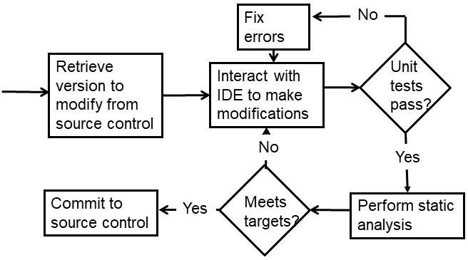
Workflow in development environment

Slide 40
Unit tests
Execution tests include
sunny-day tests conditions
rainy-day tests
regression tests
Tests should be version controlled and saved in the version control repository.

Slide 41
Static analysis
Checks code quality
Looks for particular types of patterns that may be problematic.
Generates false positives
Has severity level settings

Slide 42
Security
A static analyzer can look for known security weakness patterns.
If you package your module as a container, a scanning tool can produce a bill of materials for your container and check it against known vulnerabilities.

Slide 43
Development environment – clean up
Save the VM or container image
Check your module into the version control system.
Record information in the artifact database
The version number of the module being checked in and the version numbers of the tests.
The configuration parameters,
The version of any tools used for testing or static analysis,
The version of the IDE and any plugins used.
All resources used in the development environment should be released.

Slide 44
Discussion questions
Why must all of the unit tests be passed but not all of the static analysis tests?
Sketch a script that performs the “create” step.

Slide 45
Outline
Overview
Environments
Development environment
Integration environment
Staging environment
Deployment

Slide 46
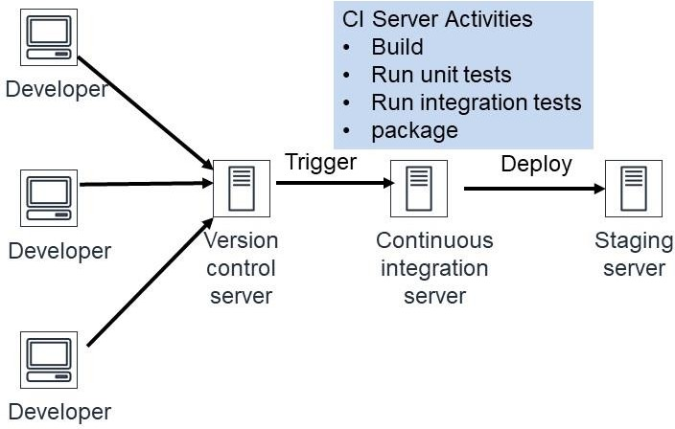
Integration environment – context
The integration environment is where the continuous integration server operates
It is triggered by a commit to the VCS
It builds an executable, runs unit tests, integration tests, and packages a deployable image

Slide 47
Integration environment—create
The Continuous Integration (CI) server requires two virtual machines.
One for the CI server itself
One is the workspace for the CI server.
Populates the test database,
Creates the test harness,
creates a VM with a load balancer,
Sets up the configuration parameters for integration,
Links either to external services or to mocks of the external services.

Slide 48
Integration environment—usage
Build a service. This is performed by the CI server.
Compile and link all the source code for the service
Load all dependencies required by the source ode
Test for functional correctness
Unit tests from all included modules
System wide tests – sunny day, rainy day, regression
Enough tests for sufficient coverage but not so many that the testing takes too much time

Slide 49
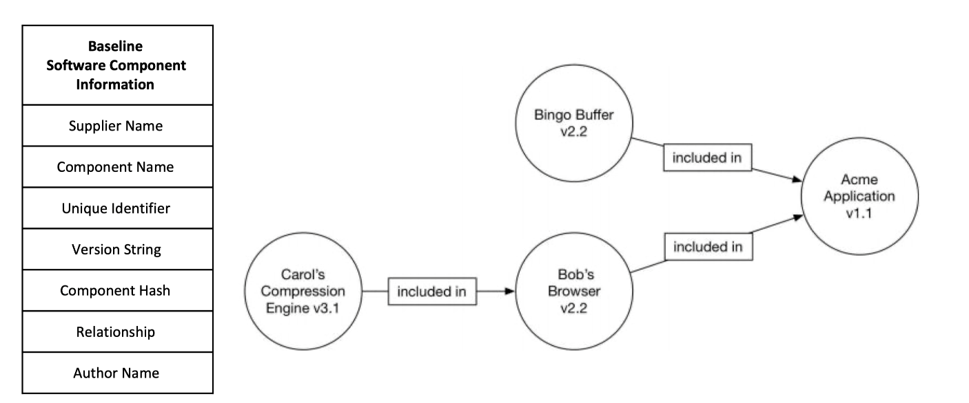
SBOM (Software Bill of Materials)
A Software Bill of Materials (SBOM) is a formal record containing the details and supply chain relationships of various components used in building software
An SBOM identifies and lists software components, information about those components, and the relationships between them.

Slide 50
What is SBOM used for?
Start with CVE (Common Vulnerabilities and Exposures)
This is a list of known vulnerabilities is software
When system is built, check if dependencies are listed in CVE.
Consequently, built system has no known vulnerabilities.

Slide 51
Time passes
When system is built, no known vulnerabilities.
Two months after deployment, a vulnerability may be discovered in one of the dependencies.
How do you know that your system now has a vulnerability?

Slide 52
Monitor SBOM
SBOM lists all dependencies
CVE lists all known vulnerabilities
Periodically (daily), a tool can check the SBOM against the CVE and discover newly listed vulnerabilities.
Log4J had a vulnerability from 2013 until 2021.

Slide 53
Test database
Data in the database should be
Representative of real data
Not too voluminous
Personally Identifiable Information (PII) should be obscured
Data base should be restored to its original state after each test.

Slide 54
Integration environment – clean up
The VM or container with that service is saved for future use.
Record information in the artifact database, including
the location of the service-specific package saved,
The version numbers and source of all the included modules,
The version numbers of all the tests run.
The version of the test tool and the continuous integration server
Configuration parameters
Release resources used by the integration environment.

Slide 55
Discussion questions
How do you obscure PII?
Why are all of the unit tests rerun in the integration step.

Slide 56
Outline
Overview
Environments
Development environment
Integration environment
Staging environment
Deployment

Slide 57
The staging environment--overview
The staging environment tests the whole system for its qualities.
performance under load,
Security
other nonfunctional qualities.
The staging environment should be as close to the production environment as practical.
Triggered by the clean up step of the integration environment.

Slide 58
Staging environment—create
The integration environment will create all the VMs or containers for your service that exist in the production environment, so they do not need to be created for the staging environment
Your service in the staging environment should not differ from that created in the integration environment.
The configuration parameters created for the staging environment should be the same as the production environment, with a few exceptions:
Use a separate staging test database
Use credentials appropriate to the staging environment
Mock any external services that your system writes to.

Slide 59
Database
The database for the staging tests should be a copy of the production database, or a large extract, if the full production database is too large.
When using production data, you must obscure any sensitive or restricted data.

Slide 60
Staging environment—usage
Testing types
Load testing
Security testing
Compliance testing
User testing
The final step in the staging environment is deployment to production

Slide 61
Load testing
Load testing has three portions
Defining the load
Applying the load
Measuring the system’s throughput and/or latency.

Slide 62
Defining the load
The contents of the oad should reflect the distribution of values that you will see in production.
It may be that your system receives mostly one type of request in production,
there may be hotspots in your database
Requests in production is may come in bursts
The number of simultaneous users may increase very slowly, or rapily

Slide 63
Sources for the load
There are three possible sources for the load:
A load-testing tool. A load-testing tool, such as Artillery, generates synthetic loads for systems. You provide the tool with a description of the input and its distribution. The tool generates synthetic loads in accordance with your description and measures the latency of the responses.
Playback. Record input to the production version of the system and use the recording as a source of test input
Tee the input to the production version. “Tee” is a Unix command that takes one input stream and generates two output streams that are identical to the input stream. One branch of the tee will go to the production version and the other to the test version.

Slide 64
Applying the load
Two approaches to applying the load
Load-testing tools, which combine load synthesis with load response.
Build a custom test harness.
Ensure that the software applying the load does not introduce any limits on the request rate during test execution – you want to be sure that you are measuring the performance of your system and not your test harness.

Slide 65
Measuring the system
Challenges to measurement
Accurately handling long-tail latency. This leads to running tests that execute so many requests that it is not practical to save the results of every request, and so the measurement framework must build latency histograms and calculate metrics on the fly.
The heterogeneous performance delivered by the underlying hardware in the cloud. Some of the physical computers may be slow because of disk or network-hardware issues, or some may have newer processors that deliver better performance. Your performance testing should cover enough time and enough physical hardware to ensure that you are accurately predicting your system’s performance in production.

Slide 66
Runtime security testing
.OWASP (Open Web System Security Project) is one tool vendor that focuses on vulnerabilities in web systems.
pen (penetration)-testing tools. They test not only for web-facing vulnerabilities but also for vulnerabilities in other portions of the stack. These types of tools are used during the staging environment to perform runtime security testing on your system.

Slide 67
Static analysis
Static analyzer tools examine the source code and look for insecure patterns of usage.
Model checking is a technique that involves symbolically testing all possible paths of a system.
Specify an error condition and the model checker will determine whether that condition can ever occur in your service.
Model checkers suffer from state explosion caused by trying to symbolically execute systems that are too large. Model checking has been applied on systems up to 10,000 lines of code and, thus far, have primarily been used for operating-system and device-driver functions.

Slide 68
Compliance testing
Test for conformance to regulations and license provisions
This is also done using static analyzers.
regulation compliance
license compliance

Slide 69
Regulation compliance
Different types of regulations impose different requirements on how your system handles data.
For example, HIPAA (Health Insurance Portability and Accountability Act) imposes a requirement that sensitive data be protected.
Other domains have their own regulatory requirements and specialized static analyzers can help determine whether the particular requirements are being met.
A static analyzer can examine the code, see if regulated data has been properly identified and highlight how it is protected. An analyst can then examine the highlighted code and determine whether the HIPAA security requirement is being met.

Slide 70
License compliance
Each type of open-source license allows you to do different things.
A static analyzer can look at all the source code included in your system and check the system’s license against a set of rules established, probably, by the legal department of your organization.

Slide 71
User testing
The user-facing portion of your service must be tested to be sure it is acceptable to users.
This may involve having actual users execute the system – a form of canary testing.
It may also involve testing how the user interface is displayed on different devices.
Common problems are inaccessible links and buttons and poor color contrast.

Slide 72
Deployment to production
Once your system has passed the tests that occur in the staging environment, the executable– whether packaged as a VM or a container–should be placed on a server for deployment into production. It may be deployed automatically, or a human may be required to authorize the deployment depending on your domain and your organization’s policies.

Slide 73
Staging environment—clean up
The final step in the staging environment is to release the resources used.
As before, artifact information is recorded in the artifact database. This information includes the URL of the testing database, the version of any tools used in this stage, and the settings of configuration parameters.

Slide 74
Discussion questions
What are the top three OWASP security vulnerabilities?
Sketch the design of a license compliance tool.

Slide 75
END OF PART 1 OF CHAP 11

